Slide 1


DECISION MAKING

Slide 2
Important of DECION MAKING
An important decision is a choice that we have to make that will have a big impact in our near future.
The decision which you make impacts your life in nearby future in two ways that is it can bring a great success and happiness in your life or it can become decision that will make you regret in rest of your life and that’s why it is really very important to choose what is best for you.

Slide 3
A decision which I had to make in my life and how it impacted my life
Every person has to take one or other important decision in life but still there is no such decision which I have took which have impacted my life greatly.
But yes one the decision of my to enhance my creativity has impacted my life .It was to peruse or to learn calligraphy I knew that it is not as easy but finally after lot of hard work I learned calligraphy. I am happy that I learned as it is one piece of my success in which I am getting a good version of myself each day.

Slide 4
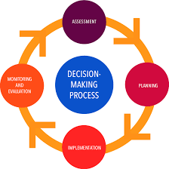
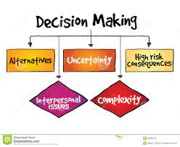
Made by :
Muskan deepak jain
Grade : 9D

